Slide 1




Project Title: In-House Money Transfer System P-Money
Organization : Palmal Group of industries
Name : Zaber Al Mamun
ID: 2022676
Summer 2024

Slide 2


TABLE OF CONTENTS
Project Key Features
04
Internship Experience
01
Implementation
05
Project Overview
02
Conclusion
06
Technical Skills
03
09
04
10

Slide 3




INTERNSHIP EXPERIENCE
01
Learned to create responsive, user-friendly web-Application using HTML, CSS, tailwind, JavaScript, and modern frameworks like React. Gained experience in front-end development.
Web Development
I conducted software testing by identifying and documenting bugs, executing test cases, and ensuring quality standards were met using both manual and automated methods.
Software Quality Testing
Learned how aligning with company values and mission improves teamwork. Saw how a positive, inclusive work environment increases productivity and creativity.
Corporate Culture
Developed skills in communication and project management. Learned to work well with others, share ideas, and achieve goals together.
Teamwork and Collaboration

Slide 4

PROJECT OVERVIEW
02
02
User-Friendly Interface
Provide a simple and intuitive interface for both administrators and users.
Transparent transaction system
View monthly salary statement easily and with proof.
Cost efficiency
70% less cost than third party companies
Hassle-free billing
Once the project is implemented the payroll service will be automated from manual

Slide 5



03
TECHINICAL SKILLS USED IN LMS
DATABASE
Front-End
HTML , CSS,
MySQL
JAVASCRIPT, tailwind

Slide 6
PROJECT KEY FEATURES
04
User Authentication
Cost efficient
User-friendly Interface
Transparency with proof

Slide 7



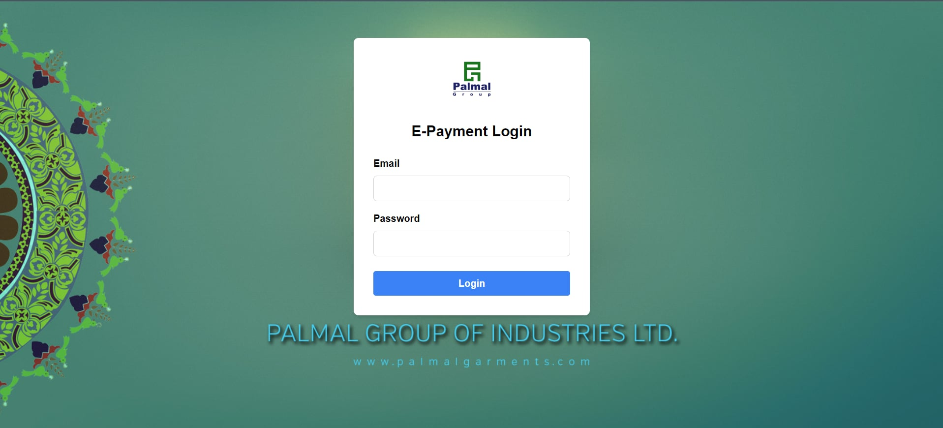
IMPLEMENTATION
05
LOGIN FORM

Slide 8
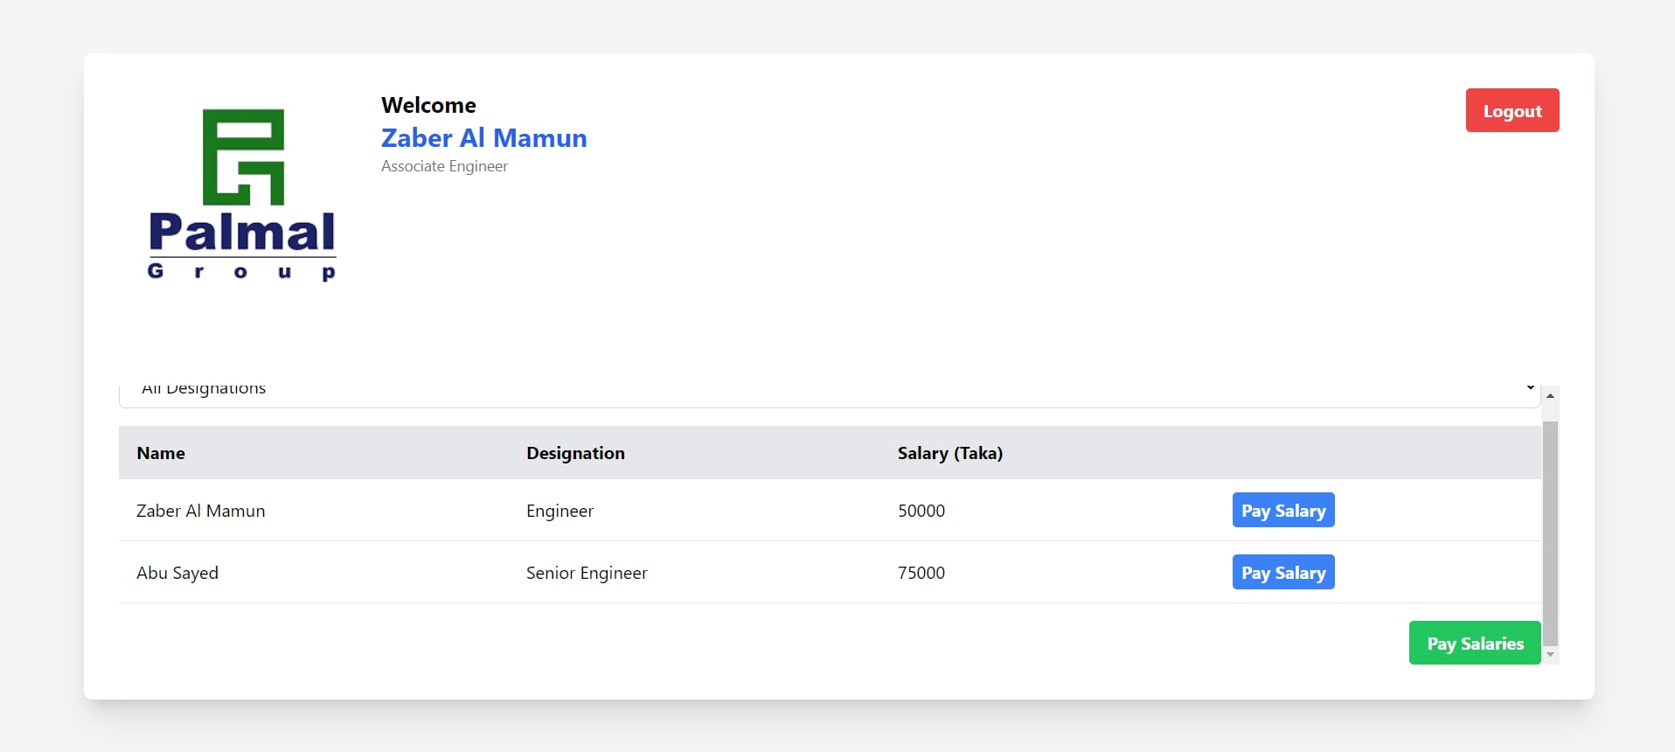
IMPLEMENTATION
06
ADMIN DASHBOARD

Slide 9
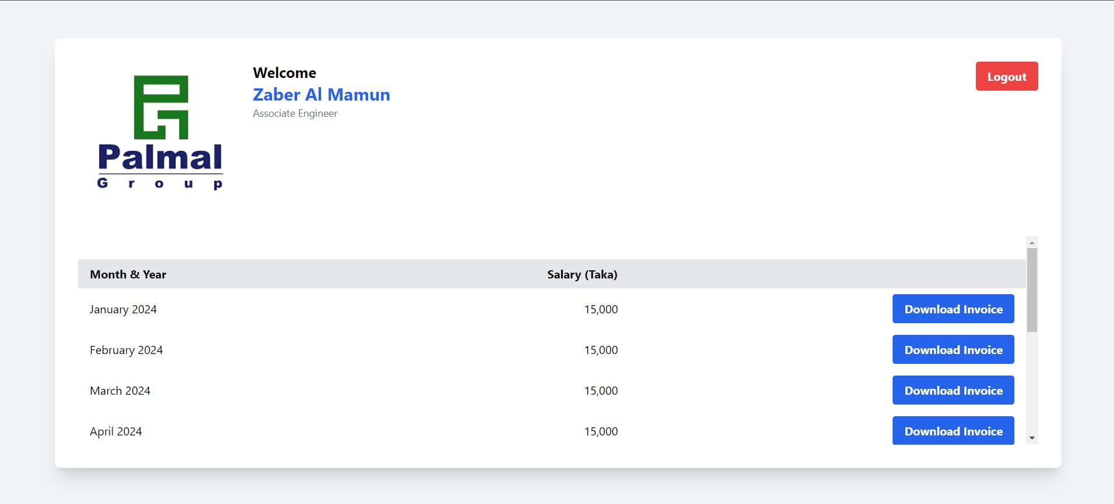
IMPLEMENTATION
07
User Interface

Slide 10


CONCLUSION
08
The internship provided a valuable learning experience.
Prepared me for future challenges in software development.
Improved web development skills

Slide 11


08
THANKS

